Slide 1
Speech Perception

Slide 2
Overview of Questions
Can computers perceive speech as well as humans?
Why does an unfamiliar foreign language often sound like a continuous stream of sound, with no breaks between words?
Does each word that we hear have a unique pattern of air pressure changes associated with it?
Are there specific areas in the brain that are responsible for perceiving speech?

Slide 3
The Speech Stimulus
Phoneme - smallest unit of speech that changes meaning in a word
  In English there are 47 phonemes:
    13 major vowel sounds
    24 major consonant sounds
  Number of phonemes in other languages varied—11 in Hawaiian and 60 in some African dialects

Slide 4
The Acoustic Signal
Produced by air that is pushed up from the lungs through the vocal cords and into the vocal tract
Vowels are produced by vibration of the vocal cords and changes in the shape of the vocal tract
  These changes in shape cause changes in the resonant frequency and produce peaks in pressure at a number of frequencies called formants

Slide 5
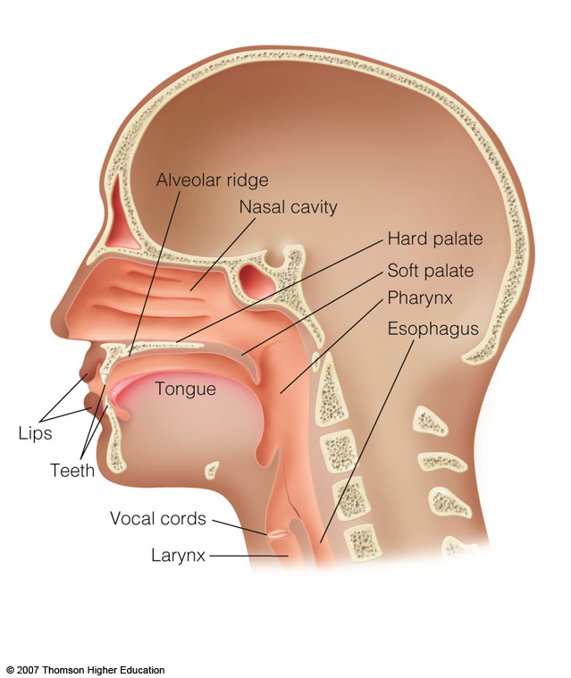
Figure 13.1 The vocal tract includes the nasal and oral cavities and the pharynx, as well as components that move, such as the tongue, lips, and vocal cords.

Slide 6
The Acoustic Signal - continued
The first formant has the lowest frequency, the second has the next highest, etc.
Sound spectrograms show the changes in frequency and intensity for speech
Consonants are produced by a constriction of the vocal tract
Formant transitions - rapid changes in frequency preceding or following consonants

Slide 7
The Relationship between the Speech Stimulus and Speech Perception
The segmentation problem - there are no physical breaks in the continuous acoustic signal
  How do we segment the individual words?
The variability problem - there is no simple correspondence between the acoustic signal and individual phonemes
  Variability from a phoneme’s context
  Coarticulation - overlap between articulation of neighboring phonemes

Slide 8
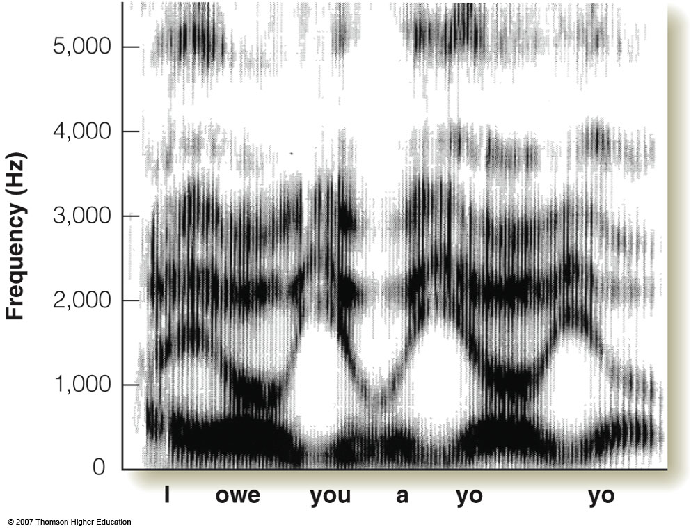
Figure 13.5 Spectrogram of “I owe you a yo-yo.” This spectrogram does not contain pauses or breaks that correspond to the words that we hear. The absence of breaks in the acoustic signal creates the segmentation problem. (Spectrogram courtesy of David Pisoni.)

Slide 9
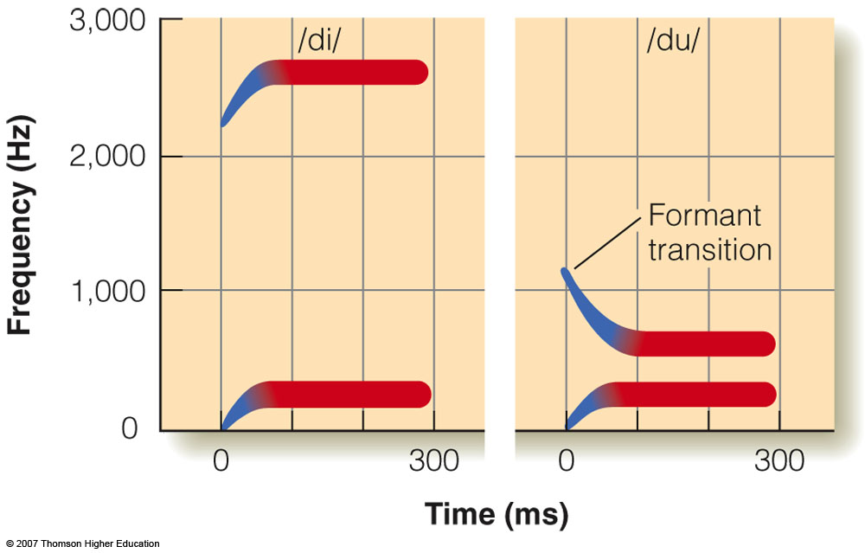
Figure 13.6 Hand-drawn spectrograms for /di/ and /du/. (From “Perception of the Speech Code,” by A. M. Liberman, 1967, Psychological Review, 74, 431-461, figure 1. Copyright © 1967 by the American Psychological Association. Reprinted by permission of the author.)

Slide 10
The Relationship between the Speech Stimulus and Speech Perception - continued
Variability from different speakers
  Speakers differ in pitch, accent, speed in speaking, and pronunciation
  This acoustic signal must be transformed into familiar words
People perceive speech easily in spite of the segmentation and variability problems

Slide 11
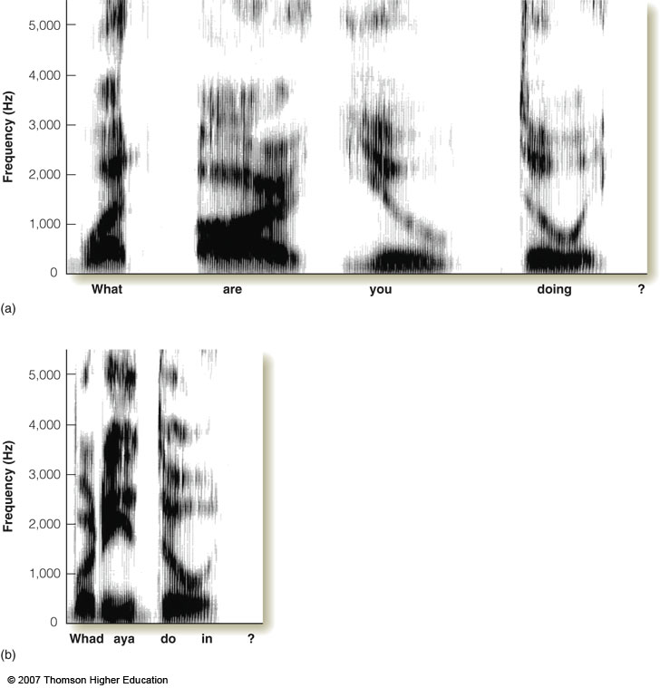
Figure 13.7 (a) Spectrogram of “What are you doing?” pronounced slowly and distinctly. (b) Spectrogram of “What are you doing?” as pronounced in conversational speech. (Spectrogram courtesy of David Pisoni.)

Slide 12
Stimulus Dimensions of Speech Perception
Invariant acoustic cues - features of phonemes that remain constant
  Short-term spectrograms are used to investigate invariant acoustic cues
  Sequence of short-term spectra can be combined to create a running spectral display
  From these displays, there have been some invariant cues discovered

Slide 13
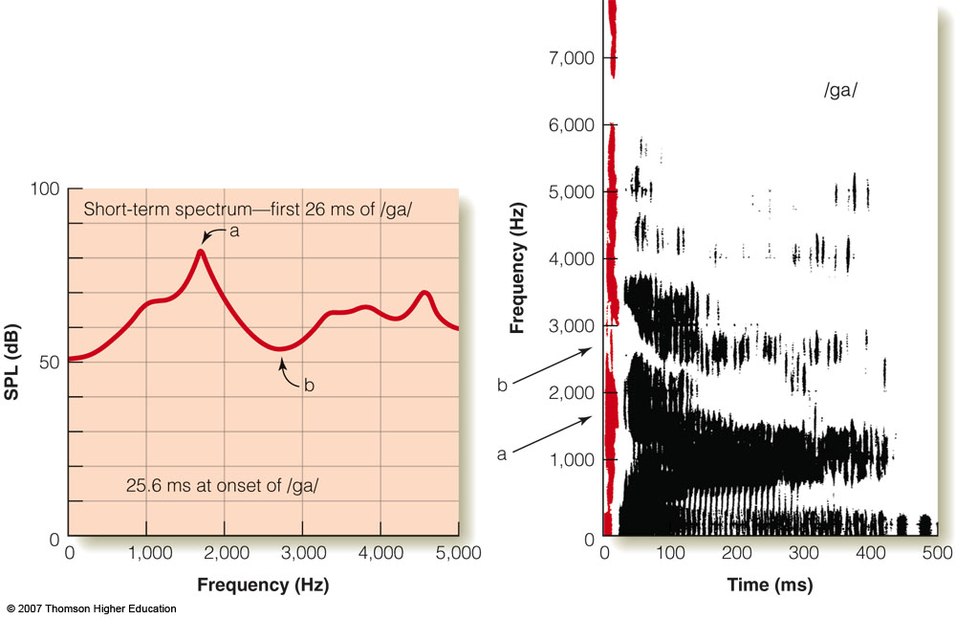
Figure 13.8 Left: a short-term spectrum of the acoustic energy in the first 26 ms of the phoneme /ga/. Right: sound spectrogram of the same phoneme. The sound for the first 26 ms is indicated in red. The peak in the short-term spectrum, marked a, corresponds to the dark band of energy, marked a in the spectrum. The minimum in the short-term spectrum, marked b, corresponds to the light area, marked b in the spectrogram. The spectrogram on the right shows the energy for the entire 500 ms duration of the sound, whereas the short-term spectrum only shows the first 26 ms at the beginning of this signal. (Courtesy of James Sawusch.)

Slide 14
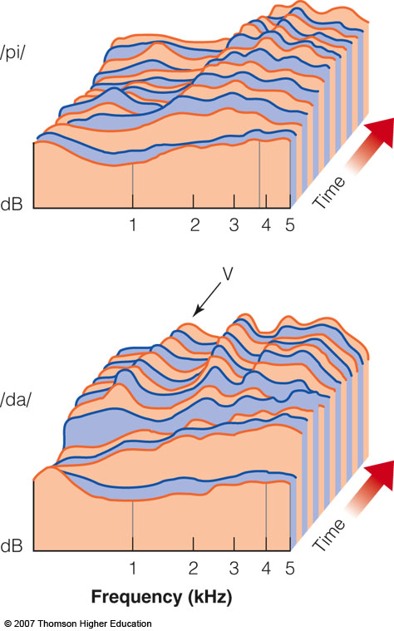
Figure 13.9 Running spectral displays for /pi/ and /da/. These displays are made up of a sequence of short-term spectra, like the one in Figure 13.8. Each of these spectra is displaced 5 ms on the time axis, so that each step we move along this axis indicates the frequencies present in the next 5 ms. The low-frequency peak (V) in the /da/ display is a cue for voicing. (From “Time-Varying Features of Initial Stop Consonants in Auditory Running Spectra: A First Report,” by D. Kewley-Port, and P. A. Luce, 1984, Perception and Psychophysics, 35, 353-360, figure 1. Copyright © 1984 by Psychonomic Society Publications. Reprinted by permission.)

Slide 15
Categorical Perception
This occurs when a wide range of acoustic cues results in the perception of a limited number of sound categories
An example of this comes from experiments on voice onset time (VOT) - time delay between when a sound starts and when voicing begins
  Stimuli are da (VOT of 17ms) and ta (VOT of 91ms)

Slide 16
Categorical perception
Listeners can only discriminate between sounds that they would identify as belonging to different categories
Notes:
Probably the most important “special” perceptual tendency of speech was categorical perception.

Slide 17
Categorical Perception - continued
Computers were used to create stimuli with a range of VOTs from long to short
Listeners do not hear the incremental changes, instead they hear a sudden change from /da/ to /ta/ at the phonetic boundary
Thus, we experience perceptual constancy for the phonemes within a given range of VOT

Slide 18
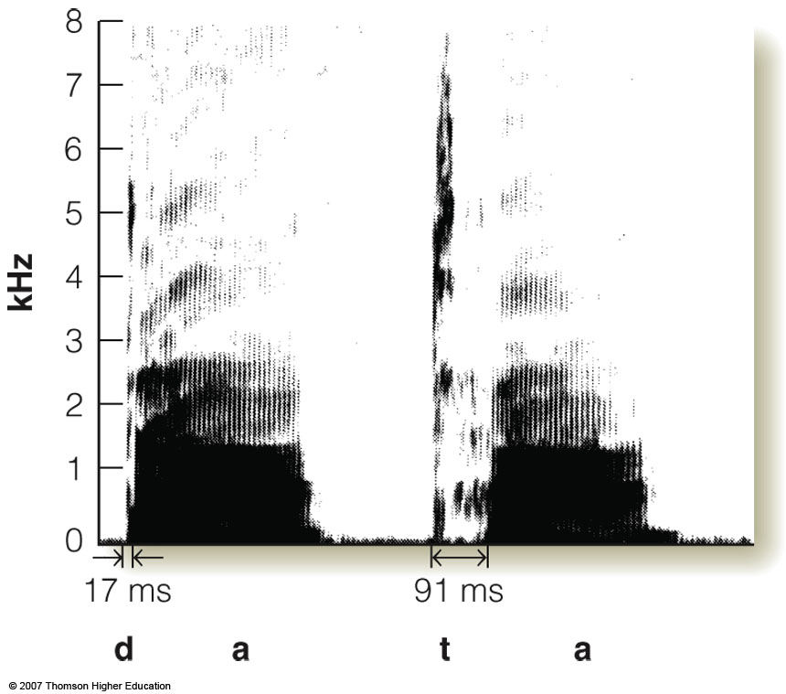
Figure 13.10 Spectrograms for /da/ and /ta/. The voice onset time -- the time between the beginning of the sound and the onset of voicing -- is indicated at the beginning of the spectrogram for each sound (Spectrogram courtesy of Ron Cole.)

Slide 19
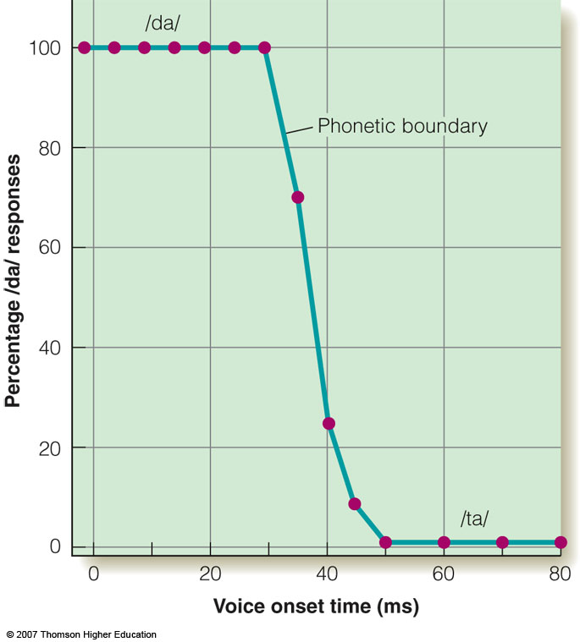
Figure 13.11 The results of a categorical perception experiment indicate that /da/ is perceived for VOTs to the left of the phonetic boundary, and that /ta/ is perceived at VOTs to the right of the phonetic boundary. (From “Selective Adaptation of Linguistic Feature Detectors,’ by P. Eimas and J. D. Corbit, 1973, Cognitive Psychology, 4, 99-109, figure 2. Copyright © 1973 Academic Press, Inc. Reprinted by permission.)

Slide 20
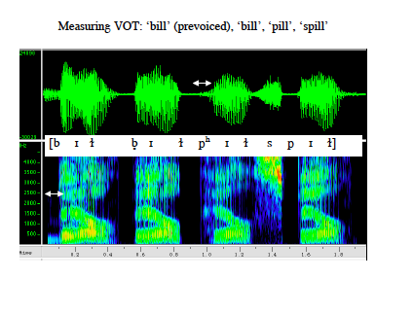
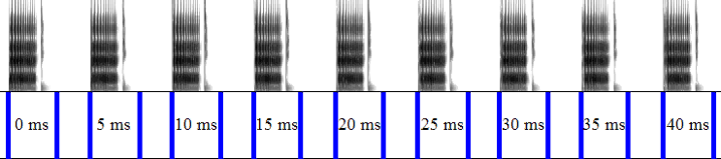
Speech acoustics can be varied along a continuum
Notes:
One can create stimuli with different VOT, for example, to determine when people hear “bet” and when they hear “pet”.

Slide 21

Identification
Was that “ba” or “pa”?
Notes:
If you present exemplars of the stimuli along this continuum to people and ask them to say which of the two phones they heard, we call that an identification task.

Slide 22
Identification functions
Category boundary
100
50
0
100
50
0
Percent “pa” responses
Percent“ba” responses
0 5 10 15 20 25 30 35 40
Voice onset time (ms)
Notes:
The results of an experiment like that are shown here. The green line shows the proportion of times that people said “ba”, the red line the proportion of times they said “pa”. If people are presented with sounds that vary in VOT along a continuum and asked to identify them as, for example, “pa” or “ba”, their identifications change rapidly from one category to another. The point where the two identification functions cross is referred to as the category boundary.

Slide 23
Discrimination
Were those the same or different?
Notes:
Now for this to be categorical perception, we have to also ask people to discriminate between the exemplars. We play two exemplars, say from adjacent positions along the continuum, and ask them whether the two sounds are the same or different.

Slide 24
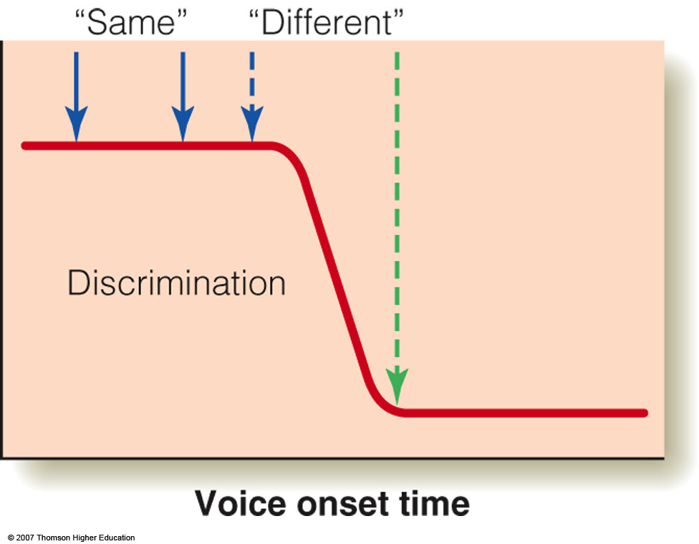
Figure 13.12 In the discrimination part of a categorical perception experiment, two stimuli are presented, and the listener indicates whether they are the same or different. The typical result is that two stimuli with VOTs on the same side of the phonetic boundary (solid arrows) are judged to be the same, and that two stimuli on different sides of the phonetic boundary (dashed arrows) are judged to be different.

Slide 25
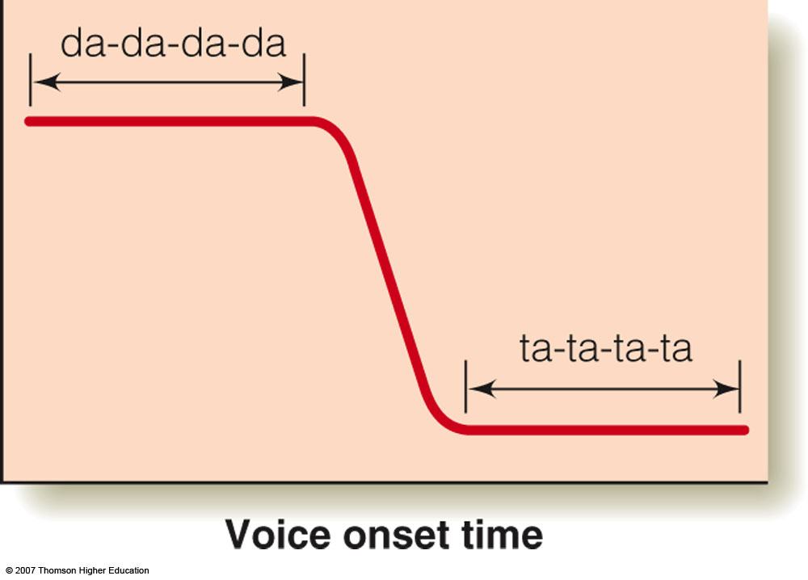
Figure 13.13 Perceptual constancy occurs when all stimuli on one side of the phonetic boundary are perceived to be in the same category even though their VOT is changed over a substantial range. This diagram symbolizes the constancy observed by Eimas and Corbit (1973) experiment, in which /da/ was heard on one side of the boundary and /ta/ on the other side.

Slide 26
Discrimination functions
Category boundary
100
50
Percent correct
0-5 5-10 10-15 15-20 20-25 25-30 30-35 35-40
Voice onset time (ms)
Notes:
This shows the results of a hypothetical discrimination experiment. The numbers on the x-axis show the two VOT that were compared. When the two VOT span the category boundary, people can discriminate them very well. When the two VOT are on the same side of the category boundary, they can’t tell them apart, even though the difference between the VOT is the same in all comparisons. People get 50% correct if they guess, or always say same.

Slide 27
Identification v. discrimination functions
Category boundary
100
50
0
100
50
Percent “a” responses
Percent correct
F1 frequency (Hz)
Notes:
So the idea here is that you could predict the discrimination result if you knew the identification result: People can only discriminate sounds that they would have identified differently.

Slide 28
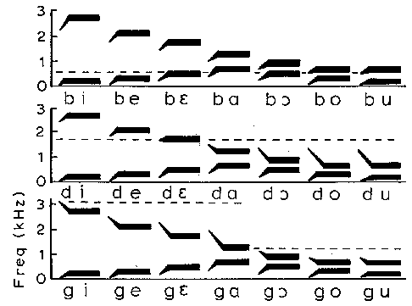
Variability in acoustics: Co-articulation
Notes:
Remember that the same phoneme in different contexts will be acoustically different. For example, these are schematic speech spectrograms of three voiced consonants played with seven different vowels. The formant transitions that designate the consonant, where the formant changes over from the consonant to the vowel can be longer or shorter or move in different directions depending on the following vowel.

Slide 29
Why would you have categorical perception?
Allows listeners to “ignore” irrelevant variations in speech signal.

Slide 30
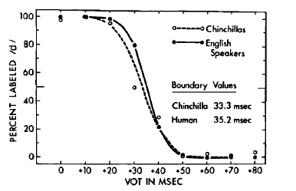
Chinchillas also have categorical perception of VOT
Kuhl and Miller, 1978
Notes:
For example, Kuhl & Miller showed that chinchillas who learned to respond when the heard /da/ but not when they heard /ga/ produced an identification function that looks just like that of humans. Because it is hard to believe that chinchillas had a special speech mechanism in their brains, this suggests that the way we categorize consonants has something to do with general auditory abilities.

Slide 31
Conclusions: categorical perception
People tend to hear speech categories, rather than the small acoustic variations across exemplars of the same phoneme.
People’s sensitivity at category boundaries reflects general auditory sensitivities, but also depends on memory and other processes.
Speech and hearing evolved together: speech takes advantage of our specific auditory sensitivities.

Slide 32
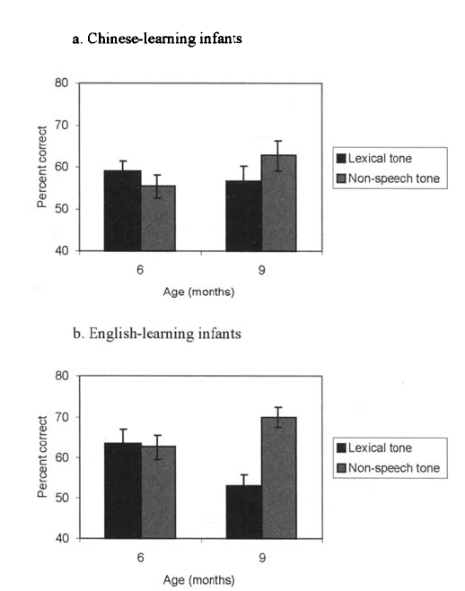
Infants lose the ability to discriminate nonnative contrasts
(Mattock & Burnham, 2006)
Notes:
These are the results of a similar experiment looking at the perception of lexical tone by infants who were learning Chinese and infants who were learning English. The infants were test on lexical tone– actual speech sounds– on discrimination of pure tones that had the same difference in shape (rising v. steady and rising v. falling). Both Chinese and English learning infants could discriminate lexical tones about as well as they discriminated nonspeech tones at 6 months, but at 9 months, the English-learning infants were worse at lexical tone, while the Chinese learning infants maintained their ability to discriminate lexical tones.

Slide 33
“Theories” accounting for cross-language differences in phonetic perception
Infants learn the phonetic contrasts of their native language from scratch.
Infants know all of the phonetic contrasts in the world, but they “forget” the ones that they don’t hear around them.
Infants know a lot of phonetic contrasts, but the boundaries between phonetic categories shift depending on what they hear.

Slide 34
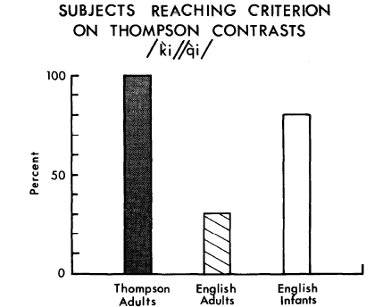
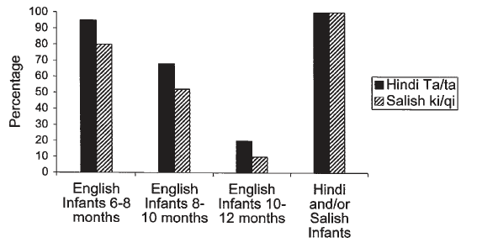
Infants lose the ability to discriminate nonnative contrasts
Werker & Tees, 1984
Notes:
These are the results of an experiment by Werker and Tees. They test Infants who were learning English, and infants who wer learning Hindi or infants who were learning Salish– the language of some native people of British Columbia on their perception of a Hindi or Salish phonetic contrast that does not occur in English and was unlikely to have been heard by English-learning infants. They also tested adult native speakers of Salish (also called Thompson) and adult native speakers of English. The results on the left compare the two groups of adults to English learning infants on the Salish (Thompson) contrast. All the Thompson (Salish) adults could discriminate the contrast; few English speaking adults could discriminate, but the vast majority of English learning infants could discriminate. This finding is consistent with a couple of our theories, that say that infants know a lot of phonetic contrasts.
The results on the right show how the ability to discriminate changes with age during infancy. Nearly all 6-8-month-old English-learning infants can discriminate both Salish and Hindi contrasts; fewer 8-10 month olds discriminate less well. Very few 10-12 month olds can discriminate– but 10-12 month old infants who are learning Hindi or Salish can all discriminate.
So something about the speech that infants hear around them is affecting their ability to hear the difference between speech sounds.

Slide 35
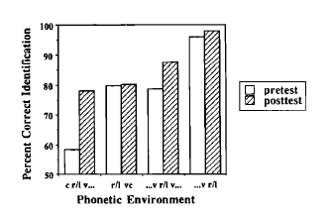
People can “relearn” nonnative distinctions
(Logan et al., 1991)
Notes:
So what happens to the nonnative distinctions that we lose in infancy and childhood? Are they gone forever? It turns out that they aren’t. People can relearn a distinction, as shown in some training study results here, for native speakers of Japanese who were trained to distinguish /r/ form /l/. Although the ability before training depended on the phonetic context, there were some cotnexts in which these listeners could hardly discriminate at all before training, but could get 80% correct or so after training.

Slide 36
General Conclusions
Auditory sensitivity constrains the phonetic distinctions that we are able to make.
Phonetic categories are organized in such a way as to optimize our ability to discriminate and to adapt to changing conditions.
Experience with speech sounds reorganizes phonetic categories, and it is the reorganization that makes it difficult to hear phonetic contrasts in the reorganized region.

Slide 37
Speech Perception is Multimodal
Auditory-visual speech perception
  The McGurk effect
    Visual stimulus shows a speaker saying “ga-ga”
    Auditory stimulus has a speaker saying “ba-ba”
    Observer watching and listening hears “da-da”, which is the midpoint between “ga” and “ba”
    Observer with eyes closed will hear “ba”

Slide 38
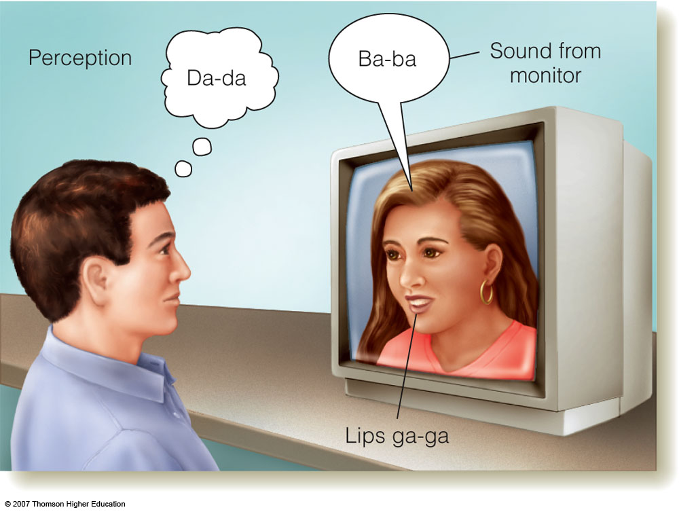
Figure 13.14 The McGurk effect. The woman’s lips are moving as if she is saying /ga-ga/, but the actual sound being presented is /ba-ba/. The listener, however, reports hearing the sound /da-da/. If the listener closes his eyes, so that he no longer sees the woman’s lips, he hears /ba-ba/. Thus, seeing the lips moving influences what the listener hears.

Slide 39
Cognitive Dimensions of Speech Perception
Top-down processing, including knowledge a listener has about a language, affects perception of the incoming speech stimulus
Segmentation is affected by context and meaning
  I scream you scream we all scream for ice cream

Slide 40
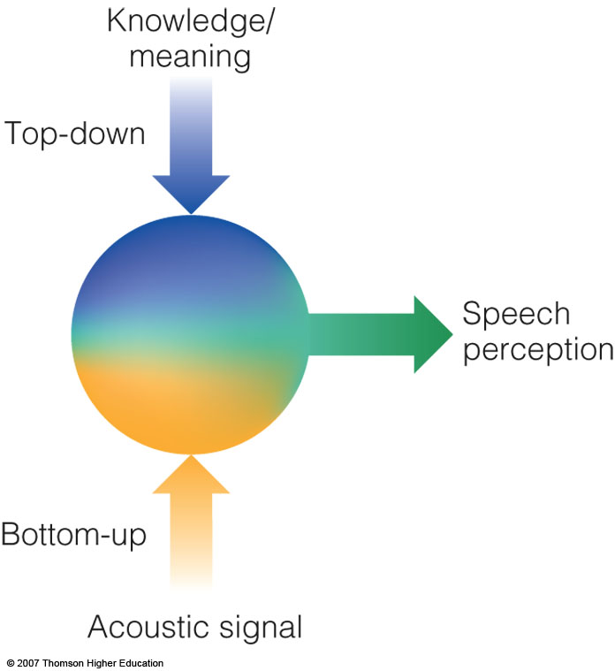
Figure 13.15 Speech perception is the result of top-down processing (based on knowledge and meaning) and bottom-up processing (based on the acoustic signal) working together.

Slide 41
Meaning and Phoneme Perception
Experiment by Turvey and Van Gelder
  Short words (sin, bat, and leg) and short nonwords (jum, baf, and teg) were presented to listeners
  The task was to press a button as quickly as possible when they heard a target phoneme
  On average, listeners were faster with words (580 ms) than non-words (631 ms)

Slide 42
Meaning and Phoneme Perception - continued
Experiment by Warren
  Listeners heard a sentence that had a phoneme covered by a cough
  The task was to state where in the sentence the cough occurred
  Listeners could not correctly identify the position and they also did not notice that a phoneme was missing -- called the phonemic restoration effect

Slide 43
Meaning and Word Perception
Experiment by Miller and Isard
  Stimuli were three types of sentences:
    Normal grammatical sentences
    Anomalous sentences that were grammatical
    Ungrammatical strings of words
  Listeners were to shadow (repeat aloud) the sentences as they heard them through headphones

Slide 44
Meaning and Word Perception - continued
Results showed that listeners were
  89% accurate with normal sentences
  79% accurate for anomalous sentences
  56% accurate for ungrammatical word strings
  Differences were even larger if background noise was present

Slide 45
Speaker Characteristics
Indexical characteristics - characteristics of the speaker’s voice such as age, gender, emotional state, level of seriousness, etc.
Experiment by Palmeri, Goldinger, and Pisoni
  Listeners were to indicate when a word was new in a sequence of words
  Results showed that they were much faster if the same speaker was used for all the words

Slide 46
Speech Perception and the Brain
Broca’s aphasia - individuals have damage in Broca’s area (in frontal lobe)
  Labored and stilted speech and short sentences but they understand others
Wernicke’s aphasia - individuals have damage in Wernicke’s area (in temporal lobe)
  Speak fluently but the content is disorganized and not meaningful
  They also have difficulty understanding others

Slide 47
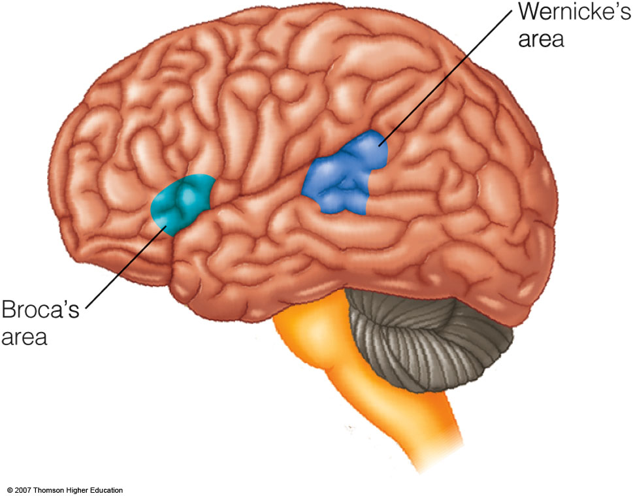
Figure 13.16 Broca’s and Wernicke’s areas, which are specialized for language production and comprehension, are located in the left hemisphere of the brain in most people.

Slide 48
Speech Perception and the Brain - continued
Measurements from cats’ auditory fibers show that the pattern of firing mirrors the energy distribution in the auditory signal
Brain scans of humans show that there are areas of the human what stream that are selectively activated by the human voice

Slide 49
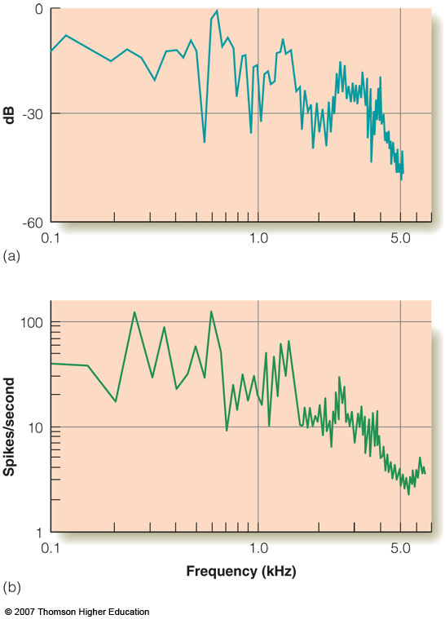
Figure 13.17 (a) Short-term spectrum for /da/. This curve indicates the energy distribution in /da/ between 20 and 40 ms after the beginning of the signal. (b) Nerve firing of a population of cat auditory nerve fibers to the same stimulus. (From “Encoding of Speech Features in the Auditory Nerve,” by M. B. Sachs, E. D. Young, and M. I. Miller, 1981. In R. Carlson and B. Granstrom (Eds.) The Representation of Speech in the Peripheral Auditory System, pp. 115-130. Copyright © 1981 by Elsevier Science Publishing, New York. Reprinted by permission.)

Slide 50
Experience Dependent Plasticity
Before age 1, human infants can tell difference between sounds that create all languages
The brain becomes “tuned” to respond best to speech sounds that are in the environment
Other sound differentiation disappears when there is no reinforcement from the environment

Slide 51
Motor Theory of Speech Perception
Liberman et al. proposed that motor mechanisms responsible for producing sounds activate mechanisms for perceiving sound
Evidence from monkeys comes from the existence of mirror neurons
Experiment by Watkins et al.
  Participants had their motor cortex for face movements stimulated by transcranial magnetic stimulation (TMS)
Notes:
The instructor should refer back to the earlier discussion of mirror neurons in Chapter 10.

Slide 52
Motor Theory of Speech Perception - continued
  Results showed small movements for the mouth called motor evoked potentials (MEP)
  This response became larger when the person listened to speech or watched someone else’s lip movements
In addition, the where stream may work with the what stream for speech perception

Slide 53
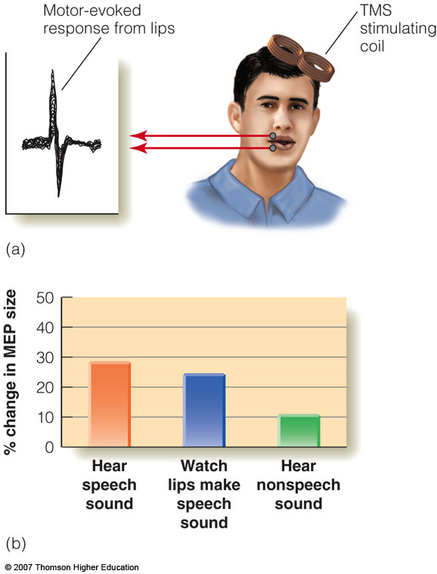
Figure 13.18 The transcranial magnetic stimulation experiment that provides evidence for a link between speech perception and production in humans. See text for details. (Reprinted from Neuropsychologia, 41, Watkins, K. E., Strafella, A. P., & Paus, T., Seeing and hearing speech excites the motor system involved in speech production., 989-994, (2003), with permission from Elsevier.)

